Slide 1
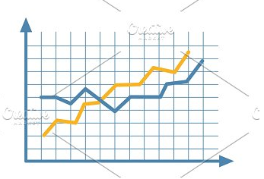
Forecasting Rainfall using Historical Data
ALY6020- Second Quarter, Term B, Dr. Tammy Wang
Project Plan
for Final Capstone Project
Assignment Completion Date: 03/30/19
Manvinder Kaur [NUID: 001402192]
Silicon Valley, Northeastern University, CA.

Slide 2

Introducing Dataset:
Rain in Australia
This dataset contains daily weather observations from numerous Australian weather stations. It covers data of 49 countries with few categorical and rest continuous numerical fields.
This dataset contains the information for 10 years from year 2007 to 2017.
The target variable is Rain Tomorrow means: Did it rain the next day? Yes or No.

Slide 3

Model Implementation
Methods/Models planning to implement
✓: K Nearest Neighbors (KNN)
✓: Decision Tree Classifier
✓: Random Forest Classifier
✓: Linear Regression
✓: Logistic regression

Slide 4
Reference Page
Joe Young(Dec 2018). Rain in Australia. Retrieved from https://www.kaggle.com/jsphyg/weather-dataset-rattle-package
Notes:
This slide explains the format and purpose of a references page.
The facilitator may stress that each source referenced within the paper should also appear on the reference page, which appears at the end of the paper.
To create a references page,
center the heading—References—at the top of the page;
double-space reference entries;
flush left the first line of the entry and indent subsequent lines. To use “hanging” feature of “Indent and Space” tab, go to “Paragraph” →”Indentation” →choose “Hanging” in the ”Special” box.
Order entries alphabetically by the author’s surnames. If a source is anonymous, use its title as an author’s surname.
Note: Unlike MLA, APA is only interested in what they call “recoverable data”—that is, data which other people can find. For example, personal communications such as letters, memos, emails, interviews, and telephone conversations should not be included in the reference list since they are not recoverable by other researchers.
For specific information about entries in the reference list, go to http://owl.english.purdue.edu/owl/resource/560/05

Slide 5
The End

